Slide 1

E-WarP: A System-wide Framework for Memory Bandwidth Profiling and Management
Parul Sohal, Rohan Tabish, Ulrich Drepper, Renato Mancuso
Notes:
Furthermore
Problem of fine grained behavior of the application, perform prediction wcet of the application when regulation is applied to cpus and acc. Full system

Slide 2
ACC.
GPU
C₁
C₂
C₃
C_{m}
…
DDR
Notes:
Modern embedded systems, have multiple cores running multiple applications of different criticality. All these applications have different memory requirements and the problem of contention at the DRAM subsystem is widely known in the real time community. Hence, there exist many works that try to mitigate this contention and provide isolation guarantees. But the problem of contention is bound to get worse now, that embedded platforms not only have the cores accessing the DDR but many DMA capable peripheral devices such as accelerators, nics, gpus, etc

Slide 3
Problems to Tackle
Memory-bound Progress
CPU-bound Progress
Worst number of memory transactions
Worst-case CPU-only execution time
Task Profile
Time
Bandwidth
Time
Notes:
So, a general application goes through multiple stages through its entire execution time. An application, initially makes a bunch of memory trans. For initialization or other purposes, go through a stage which mostly involves computation, and back and forth until the application is completed. Even within these stages there is a lot of discrepancy. If we look at the bandwidth required as the application progresses. Even when the application is going through a stage with memory transactions, it does not extract constant bandwidth but goes through high bw requirements and lows. When a compute section is executing, the bandwidth extracted becomes null and the variation in bw requirements continue till the end.
Even though, what I have shown is coarse grained interleaving, these changes in stages could be much faster.
The typical approach in the literature for analyzing such applications is to collect the worst number of memory transactions via cache misses or some other method together and also collect the maximum amount of time spent on execution. It is not the only way, but it captures a good deal of recent works. But when you approximate the worst case behavior of the application by these two factors a lot of information is lost about the trends and patterns of the memory transactions and the bandwidth requirements over the length of the applications lifespan. Furthermore, in doing such approximations it adds a lot of pessimism into the predicted runtimes of the applications under bw management.
So, our work tries to better capture the changes in memory requirements of the application in isolation and using that decrease the pessimism in the predictions.

Slide 4
Problems to Tackle
ACC.
GPU
C₁
C₂
C₃
C_{m}
…
Memory Bandwidth Management
? ?
DDR
Notes:
So, we have many cores making main memory requests which leads to contention. And as mentioned earlier a plethora of works exist in literature that have memory bandwidth management techniques for multiple cores.
We intent to improve these approaches by using more information about the memory behavior of the application but also have addition novel support in embedded platforms to regulate traffic from accelerators (in our hardware named apex). As focusing just on cores is not enough anymore and other DMA capable devices have emerged as important components in the embedded community.
So, to summarize, in this paper, we try to offer a systematic approach to not only learn more about the behavior of memory of applications. But also we show how to integrate the management of traffic coming from tasks running on both CPUs and accelerator simultaneously.

Slide 5
Knowledge is Power
C1
C2
C3
Main partition, profiled cores
Bare-metal Profiler
C4
Array of samples stored in memory
Memory-mapped Profiling registers
Config &
Control
Interface
...
DDR1
(1 GB)
DDR2
(1 GB)
CONF
S1
S2
Sn

Slide 6

Profiler in Action
CPU Activity
BW (MB/s)
Time (msec)
ACC. Activity
BW (MB/s)
Time (msec)
DCU. Activity
BW (MB/s)
Time (msec)
Notes:
In this slide I show the profiler in action and how some of the raw data collected from the profiler looks. We look at the profiles of a vision benchmark RoI, short for Region of Interest. It runs not only CPU but an accelerator as well. As mentioned earlier. The accelerator is called APEX on this hardware.
On the x-axis we have time in miliseconds. It goes for the entire execution period of the application. On the y-axis we have the bandwidth extracted by the application. We can see the profiler, not only gives us bandwidth over a very fine grained interval delta but does so for both read and write traffic separately. We can see the read in red and write in blue. This profile gives us much more insight over the bw requirements than the previous methods.
As this benchmark runs on APEX too, we can get a similar profile for the memory activity of that processing element individually.
The profiler is a powerful tool that gives us a unique opportunity to learn the behavior of controllers that are out of our control, of other components that may consume bw in our case this curve showed up. In our platform there is a continuous activity from the display control unit. We can see it mostly reads as it is copying from memory to display.
This is a key example of how the profiler gives us predictability in our system as this traffic will now be accounted for in our analysis, but we would have had no way to know about this without the profiler.

Slide 7

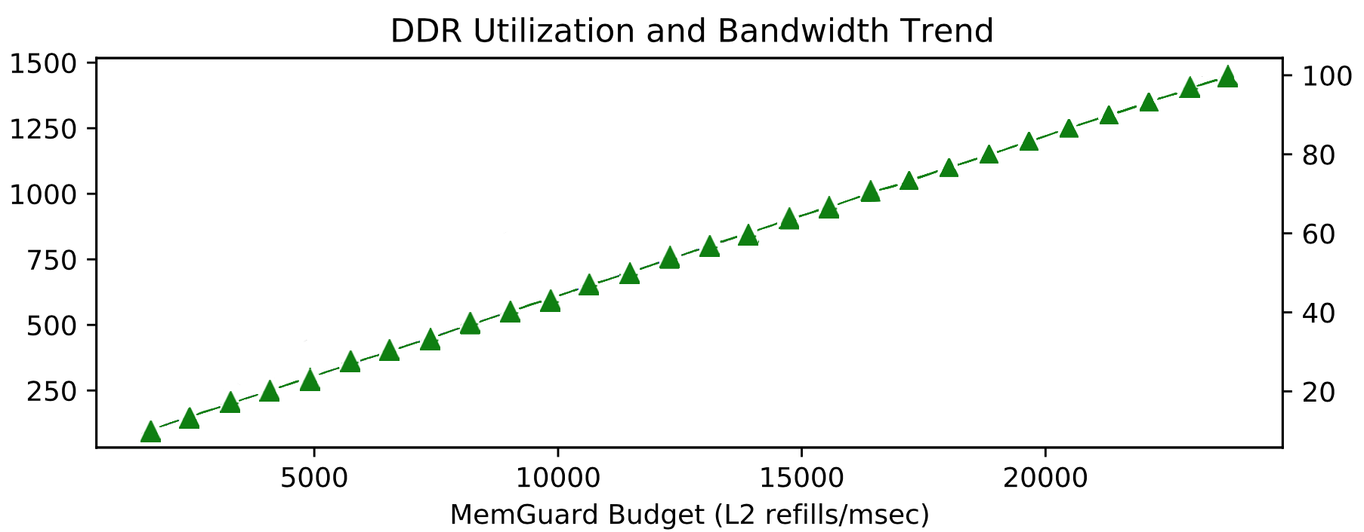
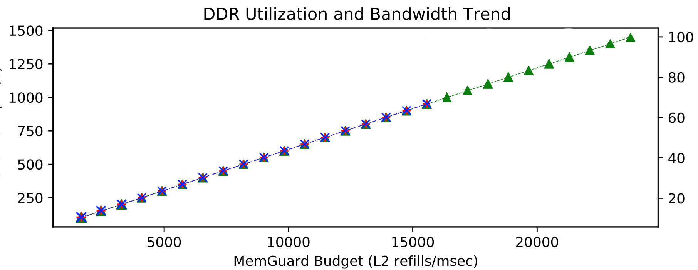
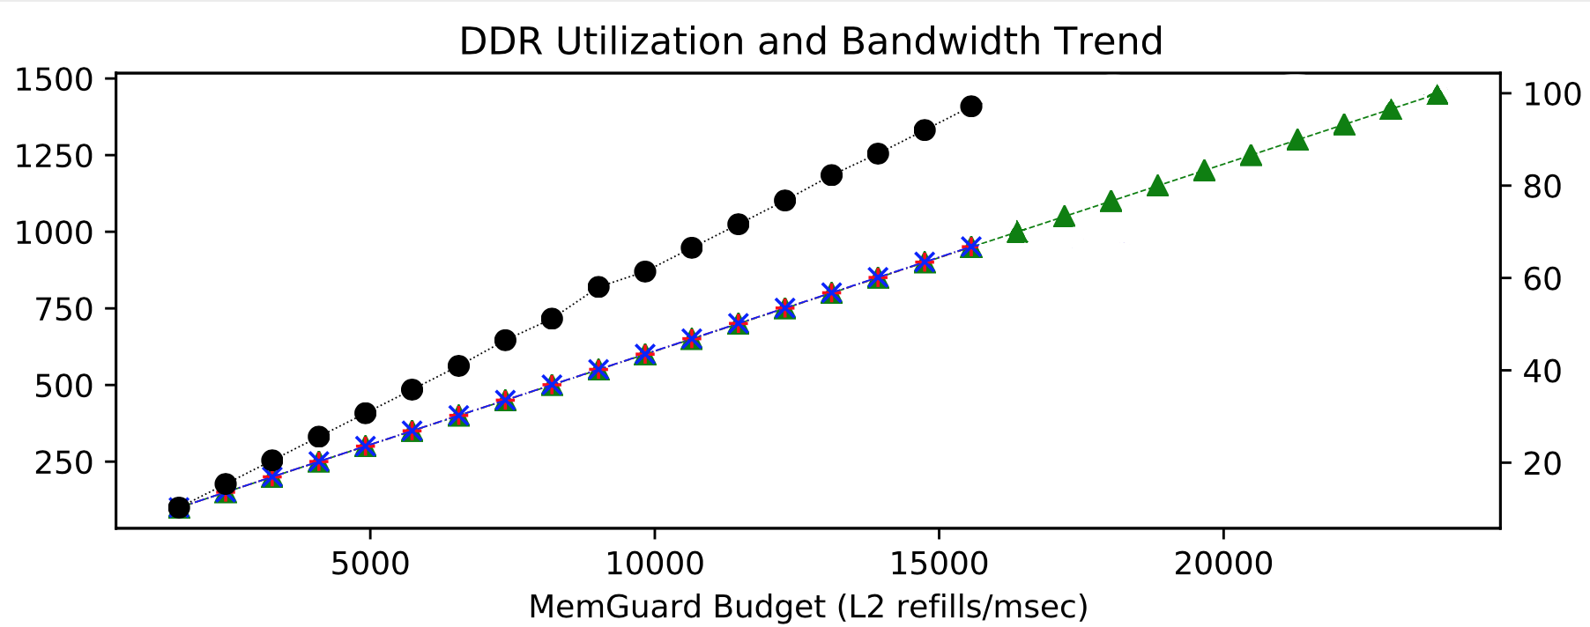
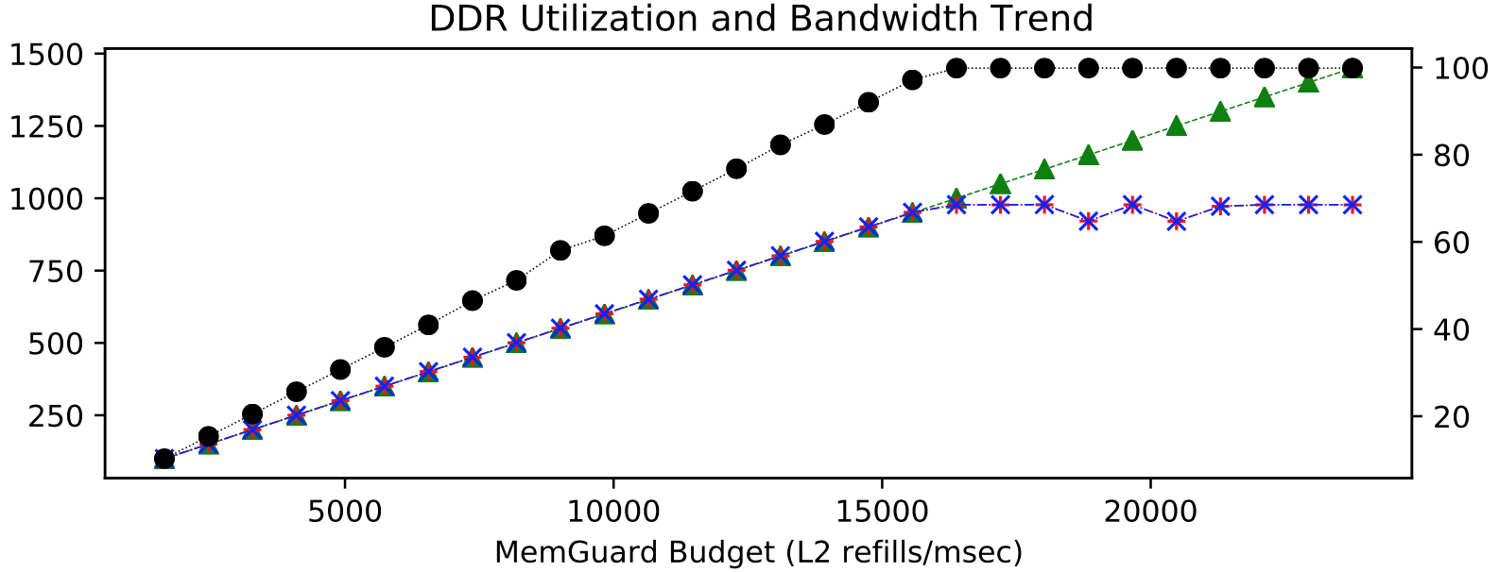
Instantaneous Utilization
Util. (%)
Time (msec)
Bandwidth (Mb/s)
DRAM Util. (%)
Notes:
Furthermore, the profiler also helps us understand utilization of the DDR.
So, let us see how for the benchmark shown in the previous slide how does utilization look like. On the x-axis we have time as usual depicting the execution time of the application and on the y axis we have the DDR utilization in percentage. As would be expected as the application extracts different amount of bandwidths at different stages, either from the CPU or APEX the utilization also goes up and down. The utilization shows the total utilization that includes all the processing elements that application used. Even one application at certain time can drive the utilization to 100% and saturate the DRAM subsystem.
But why do we care about utilization? The execution time of the application ishighly affected when congestion occurs at a shared resource. Furthermore, it occurs when the resource hits saturation. So, with the profiler we can conduct a very precise study on when does the bw extracted from a resource cause DRAM to go into saturation. And that is why care about utilization.
So, we ran this experiment with a stress benchmark. On the x-axis we have the budget (I will discuss how we set it and what techniques we use in later slides). On the y-axis on the left we have bw and the y-axis on the right we have DRAM utilization. As the budget is increased we expect to see a linear increase in bandwidth and we measured this using the profiler. We also see the utilization of the DDR increase linearly. We can also see the reads and writes from the stress benchmark increase linearly with the bandwidth. SO, as expected the linear trend is maintained among the bandwidth and the utilization. But as soon as utilization exceeds 100%, the reads and writes bandwidth flatten out and our application is not given more bw even if more budget is allocated to it. This intuitively makes sense and the system is saturated and there is no remaining bw to allocate to the reads and write transactions and we are in uncontrolled regulation.
So, a key takeaway is that the bandwidth and utilization are linearly related until the system is below saturation. Hence, by keeping the application below saturation threshold, the system becomes highly predictable.

Slide 8
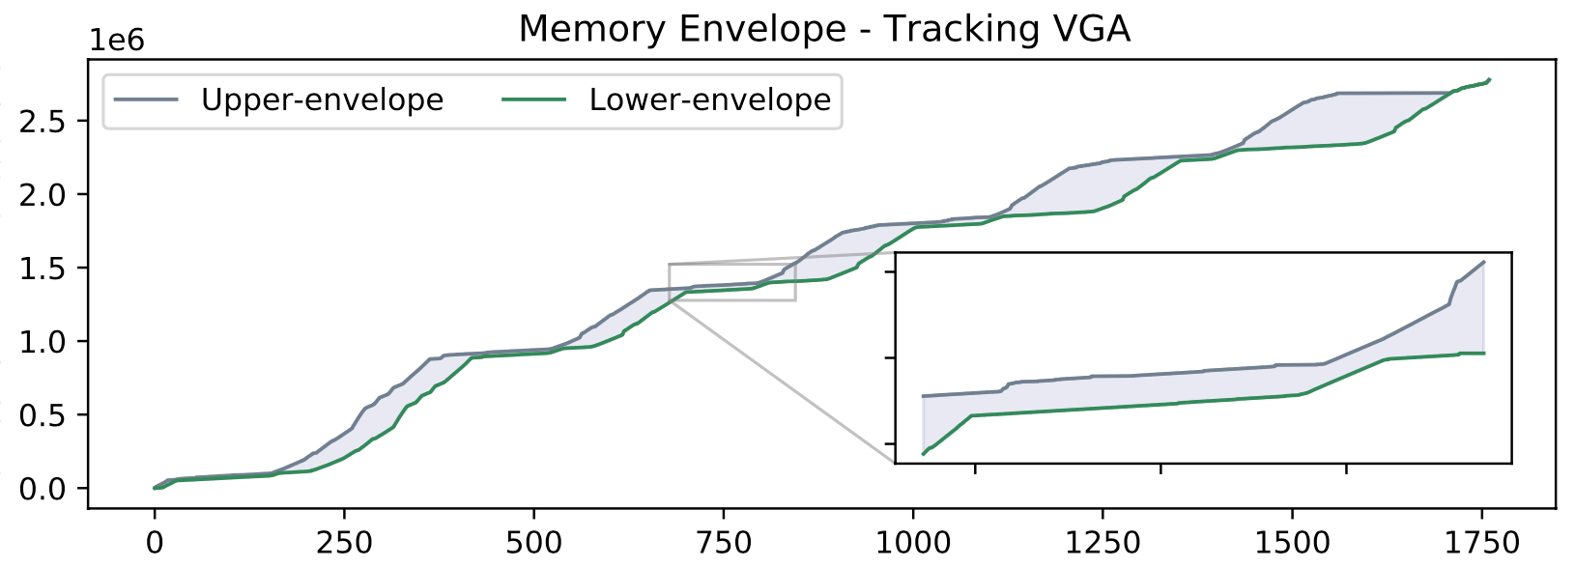
Memory-bound Progress
CPU-bound Progress
Task Profile
Cumulative Memory Transactions
Time
Cumulative
Memory
Transactions
Time
Time (ms)
Notes:
Experimental based
Mutiple times
And take the upper and lower
Lower bound then reduce the unceratainity
Much more information than just characterizing by one number, cache misses.
You get the e-warp task model for free, it can capture sequentiallly acc 1, acc2 and back cpu.

Slide 9
E-WarP Task Model
CPU
Acc.
Time
Cumul. Mem. Trans. CPU
Envelope-aWare Predictive Model
Time
Cumul. Mem. Trans. Acc.
Notes:
We can still get upper and lower envelopes.

Slide 10
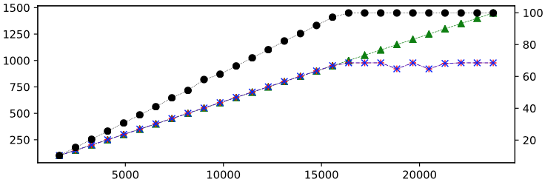
Model Memory Behavior
Understand Utilization
How do we do memory regulation?
How do we predict the temporal behavior under regulation?
Notes:
So, we have a profiler that provides us with more knowledge about the memory patterns of the applications and we encompass this information using lower and upper envelopes of cumulative memory transactions. This helps us decrease the pessimism in our predictions of WCET under regulation.
Using the profiler we have also understand the linear trend between bandwidth extracted and the utilization. The system is predictable when the saturation is maintained below a 100%.
But we have still to discuss how do we control the memory bandwidth to ensure the DRAM util stays below saturation?
Also, when these controls are added to restrict the applications memory requests to the main memory how do we predict the temporal behavior of the application?

Slide 11









Regulation
of Main Memory BW
ACCEL1
SYS
DMA1
ACCEL2
SYS
DMA2
C1
C2
C3
C4
SW-based regulation
LLC
LLC
$$Q_{mg}^{1}$$
$$Q_{mg}^{2}$$
$$Q_{mg}^{3}$$
$$Q_{mg}^{4}$$
ARM QoS regulation
Interconnect + ARM QoS 301 (or 400)
$$Q_{qos}^{1}$$
$$Q_{qos}^{2}$$
$$Q_{qos}^{3}$$
$$Q_{qos}^{4}$$

Slide 12
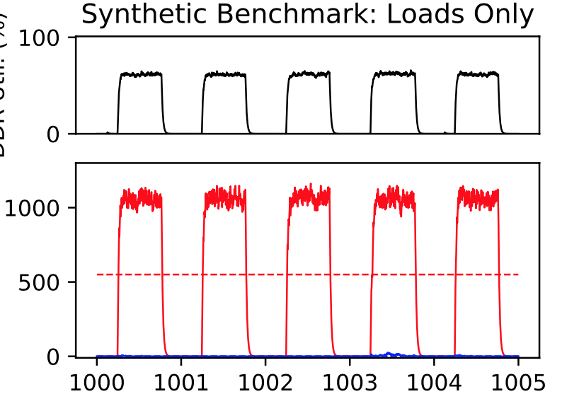
Regulation of Main Memory BW
C₁
C₂
Util. (%)
BW (MB/s)
SW –based Regulation
(MemGuard)
Time (msec)
Profile of MemGuard-regulated synthetic traffic and the corresponding DDR Utilization
DDR
Notes:
The hardware regulator is not able to differentiate between traffic from individual cores but only the total traffic from all CPUs. Hence we need a software based memory regulation technique. MemGuard is a popular mechanism used in the community. Each core has a regulator that enforces a max number of last level cache misses or budget over a given period. Hardware performance counters cause an interrupt if the budget is depleted. This cause the core to stall for the rest of the regulation period.
We used a synthetic benchmark with reads with memguard budget of around 500 MB/s. Lets see how the benchmark looks via the profiler and its contribution to the utilization. On the x-axis we have the time and the y axis we bw on the left bottom and the utilization on left top. As we can see MemGuard extracts much more than its budget in the intial part of its regulation period but then is stalled for the remaining part. And on average it extracts the amount that it was set to.
We can also look at it contribution to DDr utilization.

Slide 13
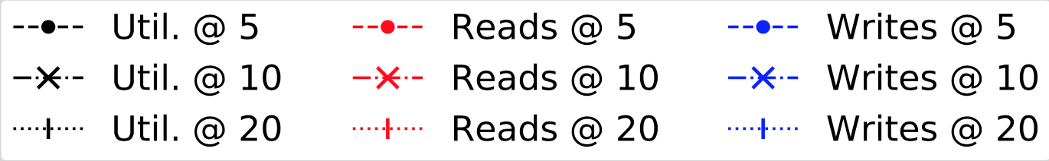
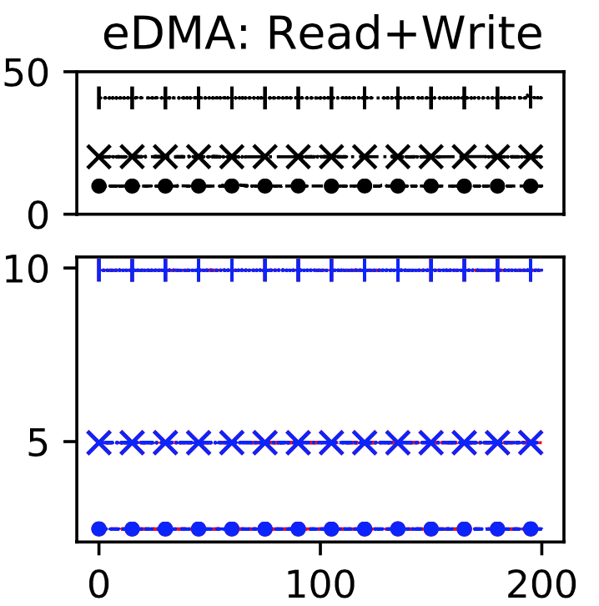
Regulation of Main Memory BW
APEX1
APEX2
CORES
Util. (%)
ARM QoS-based Regulation
BW (MB/s)
Interconnect
DDR
Time (msec)
Profile of QoS-regulated eDMA traffic and the corresponding DDR Utilization
Notes:
This is the first work to our knowledge that integrates arm QoS support to regulate memory and provide prediction guarantees.
Arm QoS uses traffic shaping on individual request that traverse the interconnect to limit the number of memory transactions. As depicted by the colored boxes on the interconnect, it can differentiate between traffic from different masters.
I will show you QoS at different levels and how it looks from the profilers perspective and its utilization.
On the x-axis we have time, lower left y-axis we have bw and upper left we have utilization. This graph is obtained by programming the enhanced dma on our platform. Unlike memguard, the traffic shaping works in a regular bw rather than a high bandwidth and the the core being stalled for the rest of the regulation period. As with MG we can still correlate QoS level with Utilization if the system is still below saturation at that level.

Slide 14
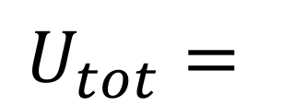

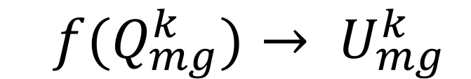

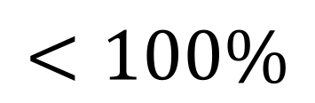
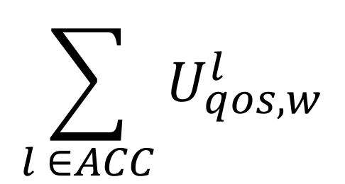

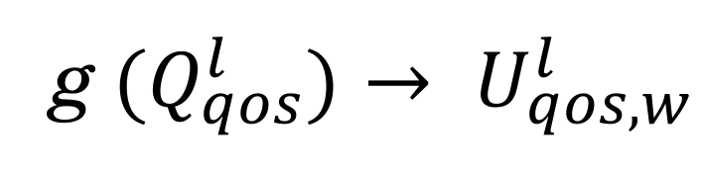
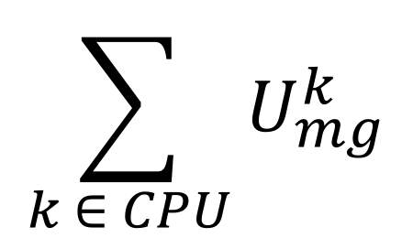
CPU
Accelerator
CORES
AcC.1
ACC.2
C₁
C₂
Per-core MemGuard Budget
Per-master
QoS Level
$$Q_{mg}^{k}$$
$$Q_{qos}^{l}$$
DDR
Interconnect
DDR
  $$f(Q_{mg}^{k})→ U_{mg}^{k}$$
g$(Q_{qos}^{l})→ U_{qos,w}^{l}$
$$\sum_{k ∈ CPU}{U_{mg}^{k}}$$
$$\sum_{l ∈ACC}{U_{qos,w}^{l}}$$
$$U_{tot}=$$
$$+$$
$$<100\%$$
Notes:
To summarize the two techniques we have for managing memory bandwidth.
size w in bytes of each transaction

Slide 15
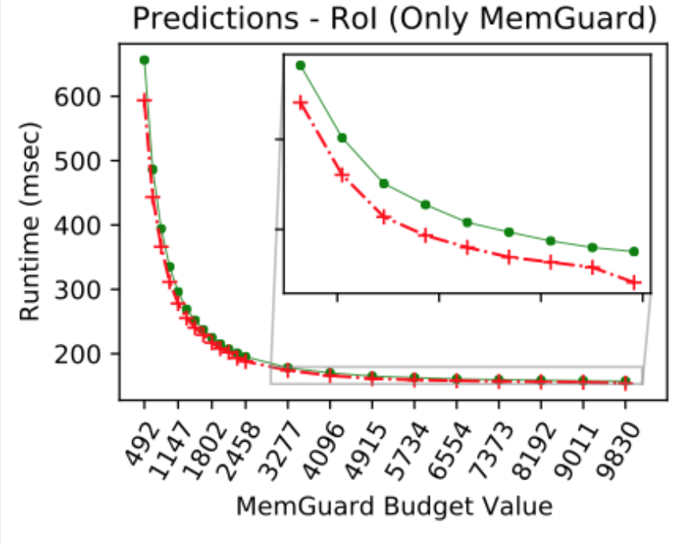
Predicting WCET under Regulation
E-WarP Task
Regulation Level
Over prediction
~6%
Prediction Algorithm
Runtime under Regulation
Notes:
We have a way to control memory bw but we still haven’t discussed how to predict the runtime of the application under regulation. So, we have an ewarp tasks, that is defined by the upper and lower cummulative memory transactions for all the processing elements involved. We also statically set the Regulation level (at this level the DRAM subsystem should still be below saturation).
Our prediction algorithm takes these two parameters and outputs the runtime under regulation. In the interest of saving time, I will skip the details of the algorithm. Please reads the paper for more details.
Lets look at one application RoI, where we only pass the regulation level for MemGuard. On the x-axis we have the budget increasing. On the y axis we have runtime in miliseconds. The green line is the predicted and the red is the measured. 2 observations to be made. Predictions are always higher than the measured as can be seen in the zoomed version clearly. Second they are close to the measured as we have a lot of information of the memory trends of the application encapsulated in the upper and lower memory envelopes.

Slide 16
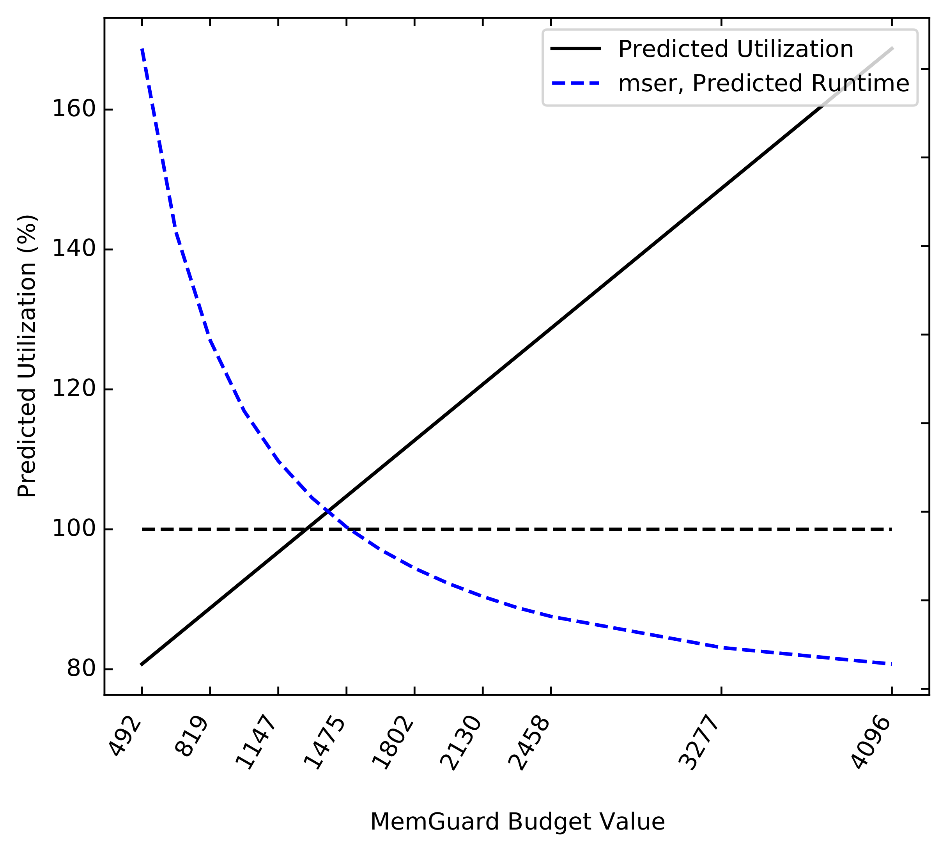
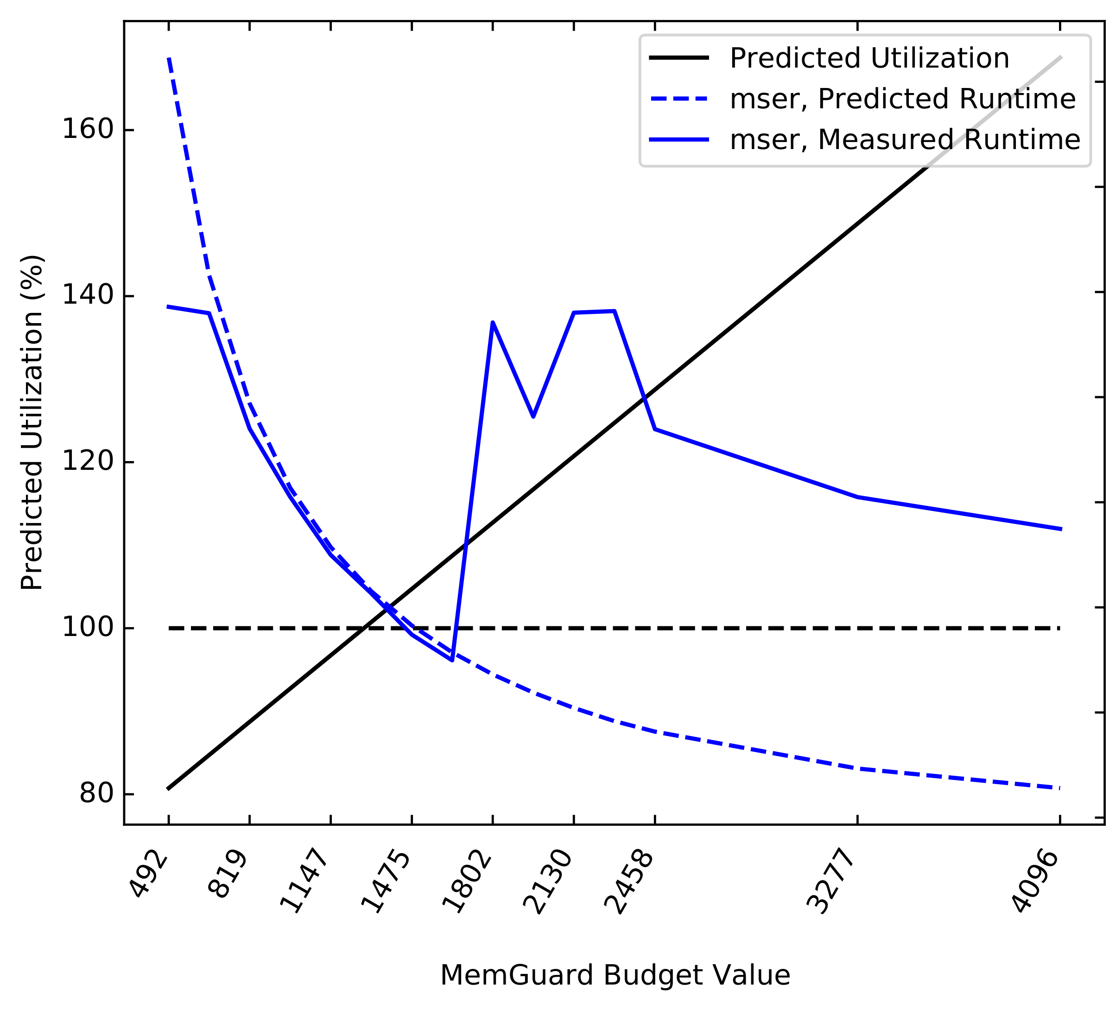
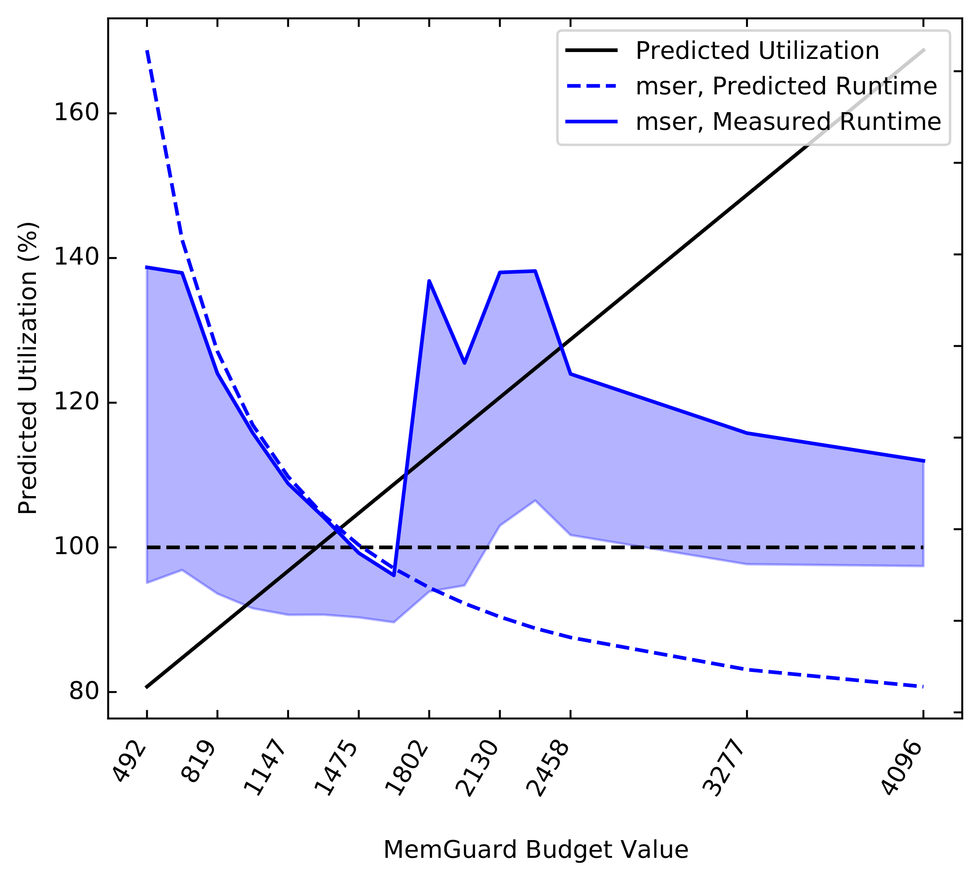
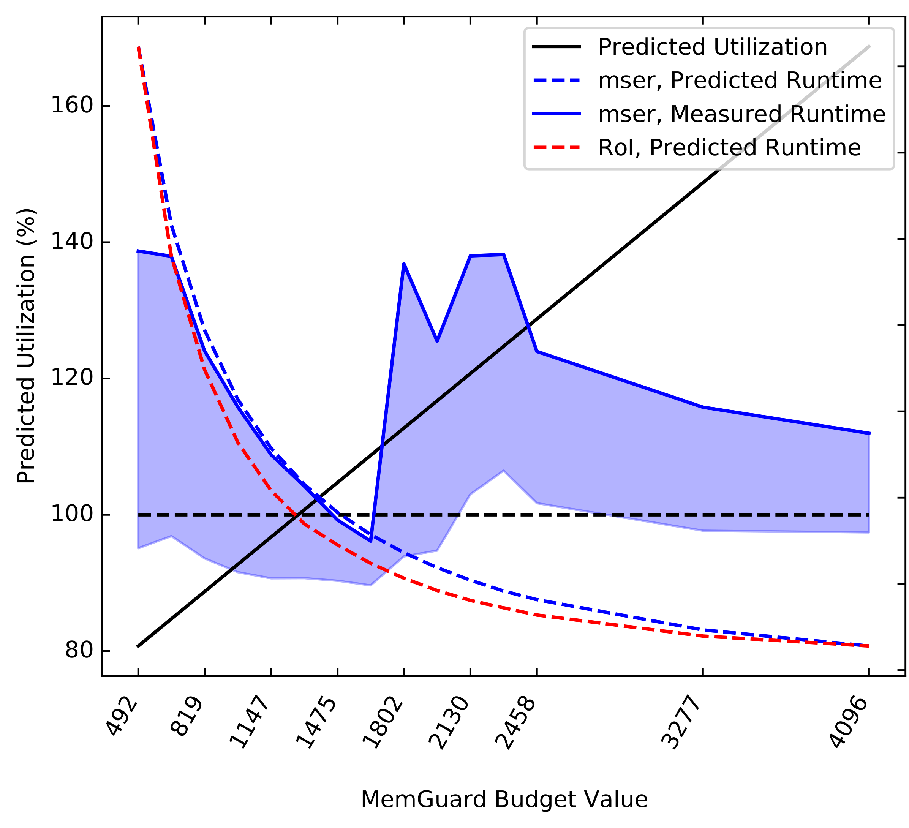
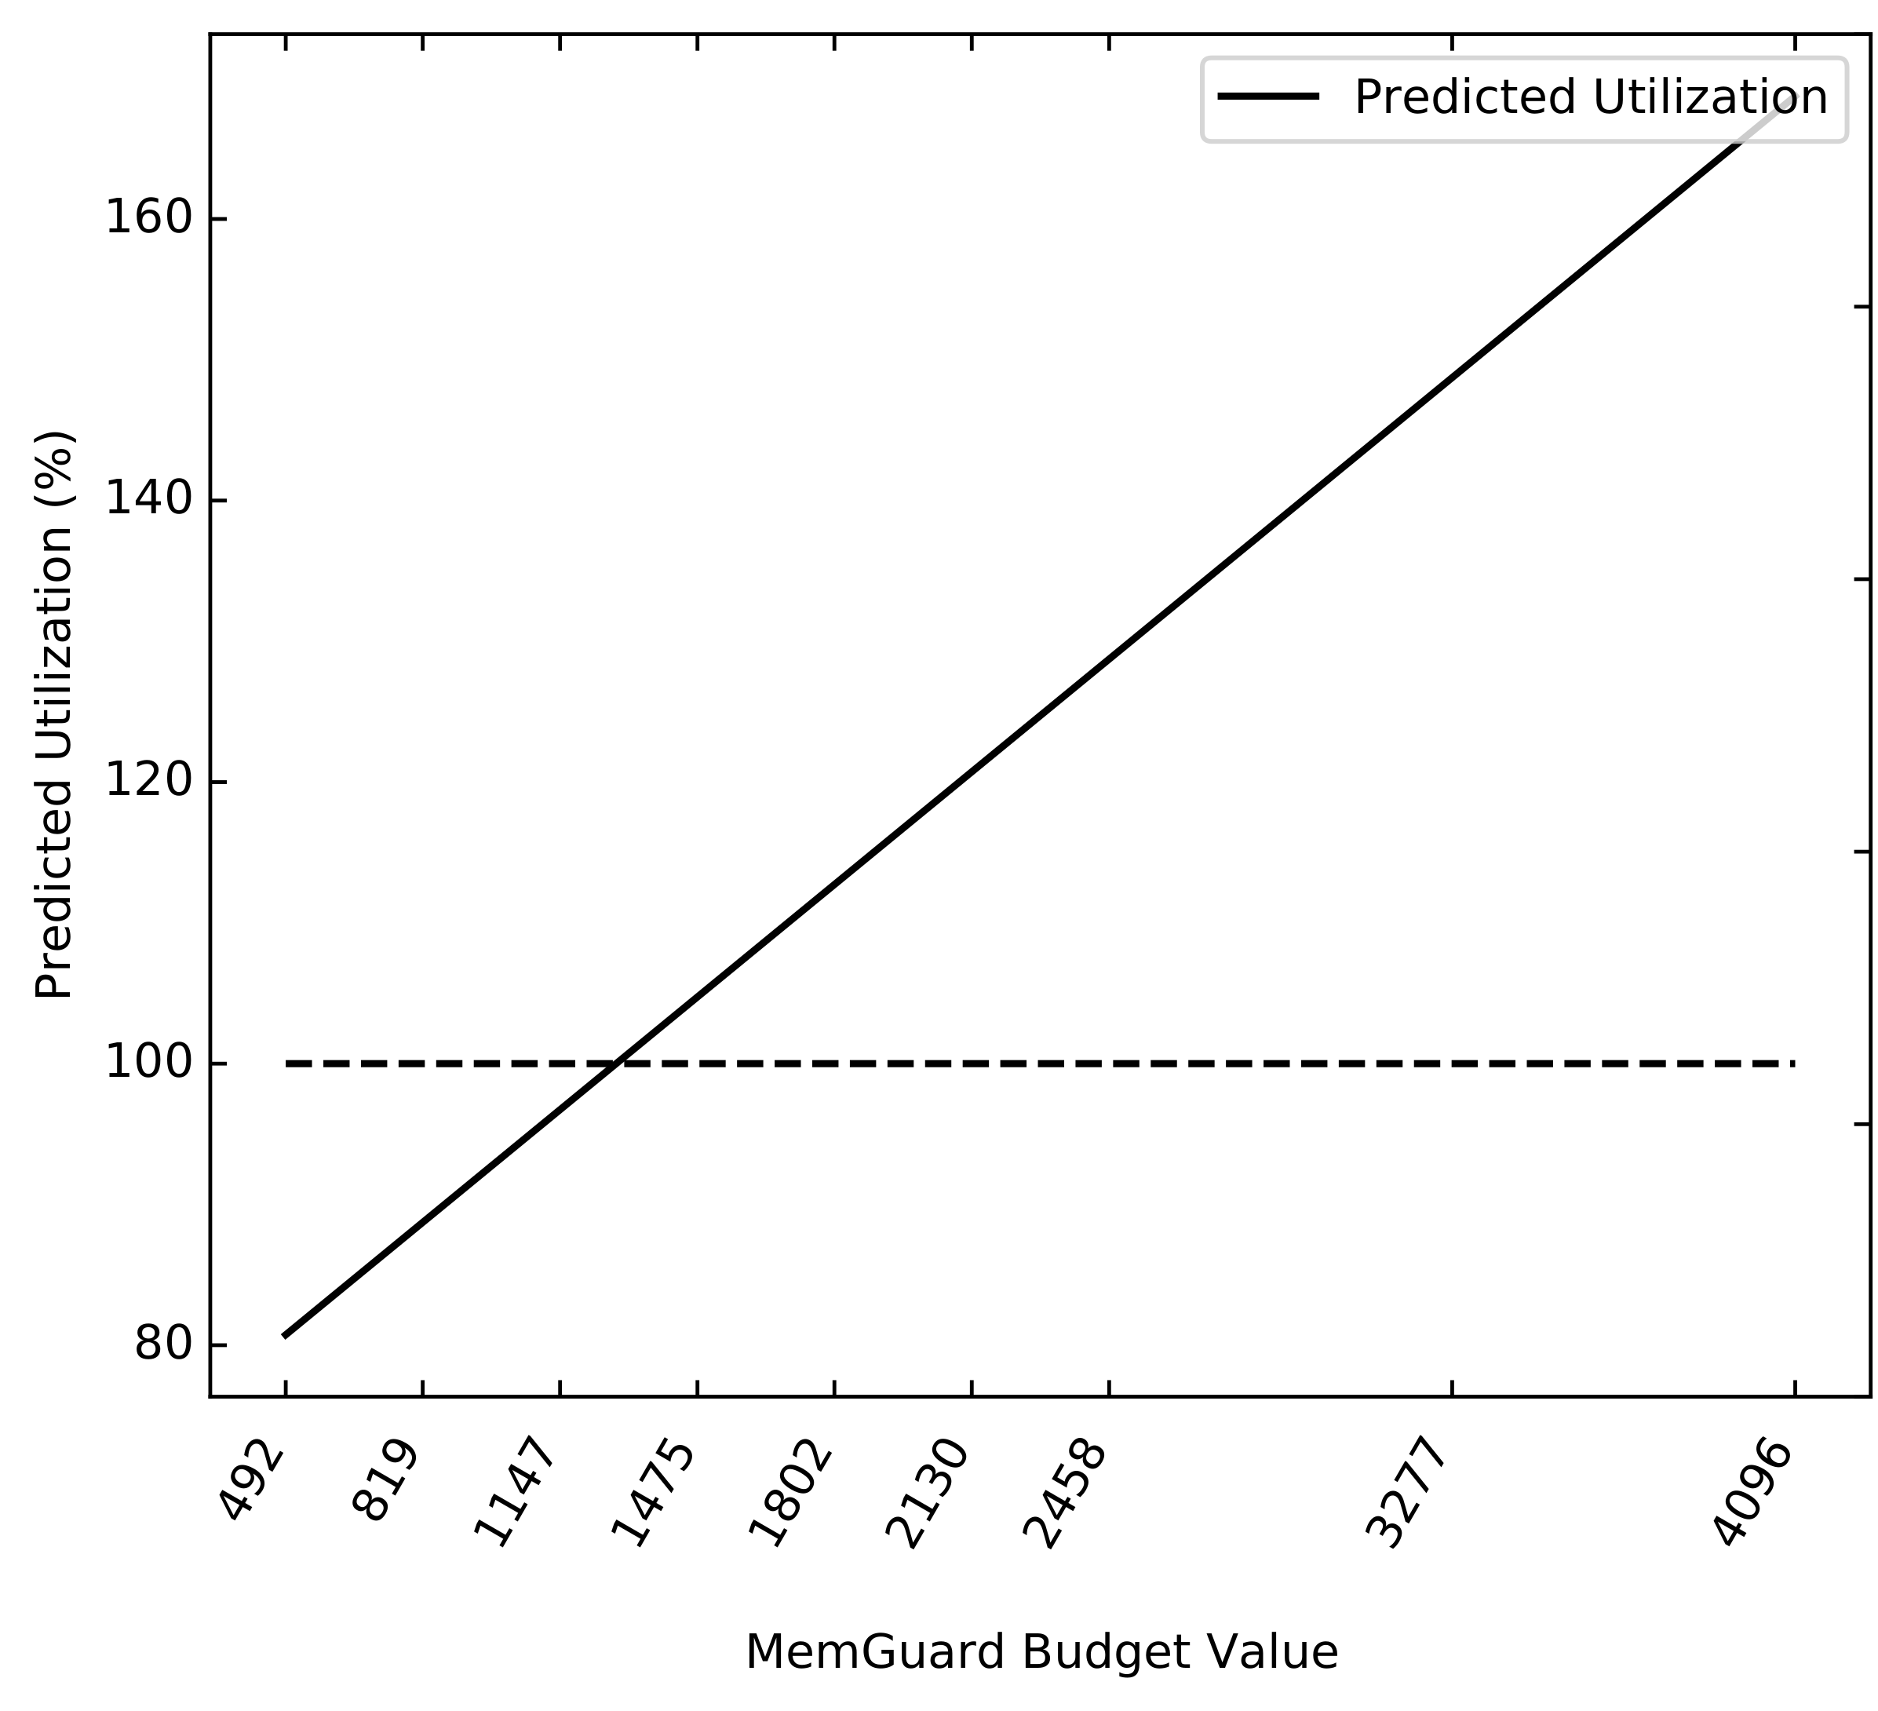
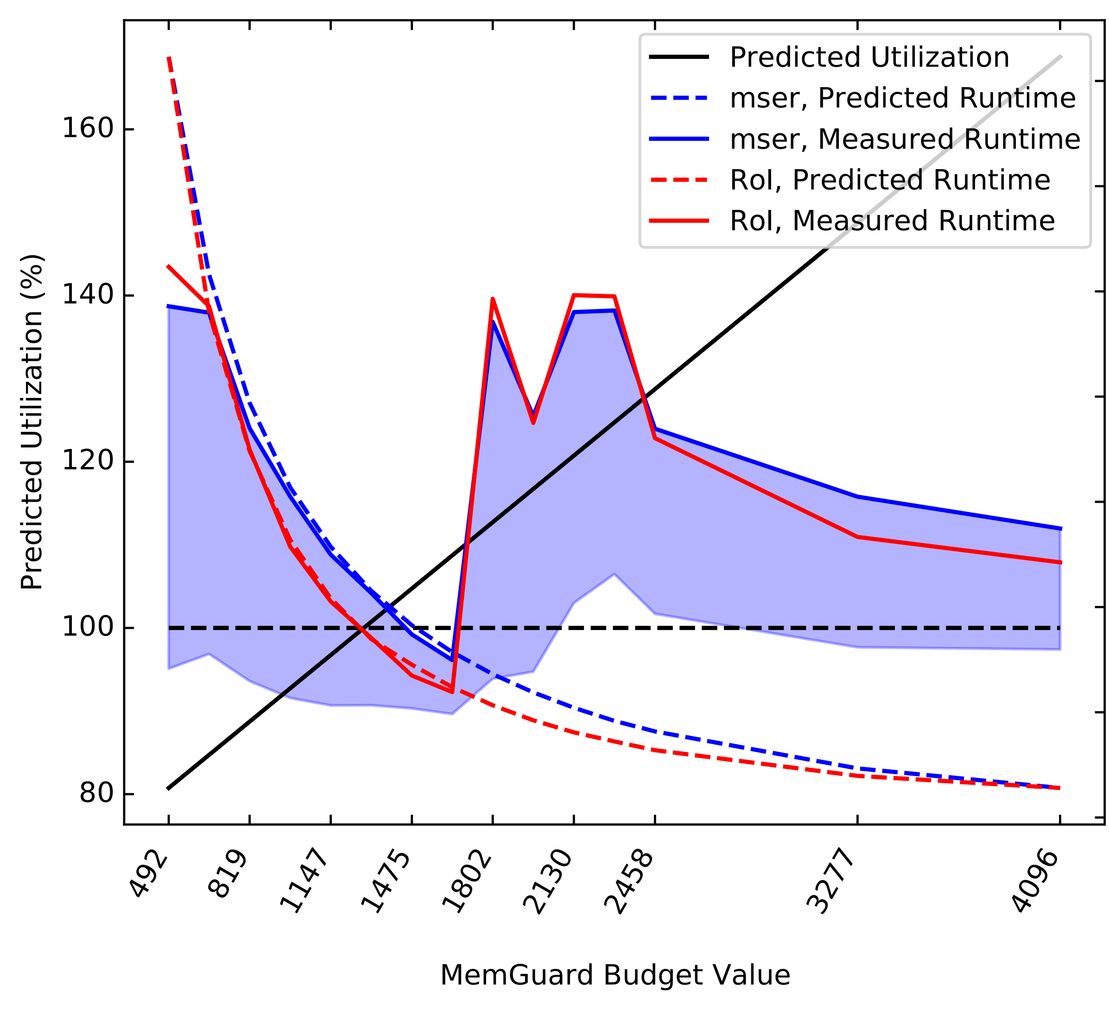
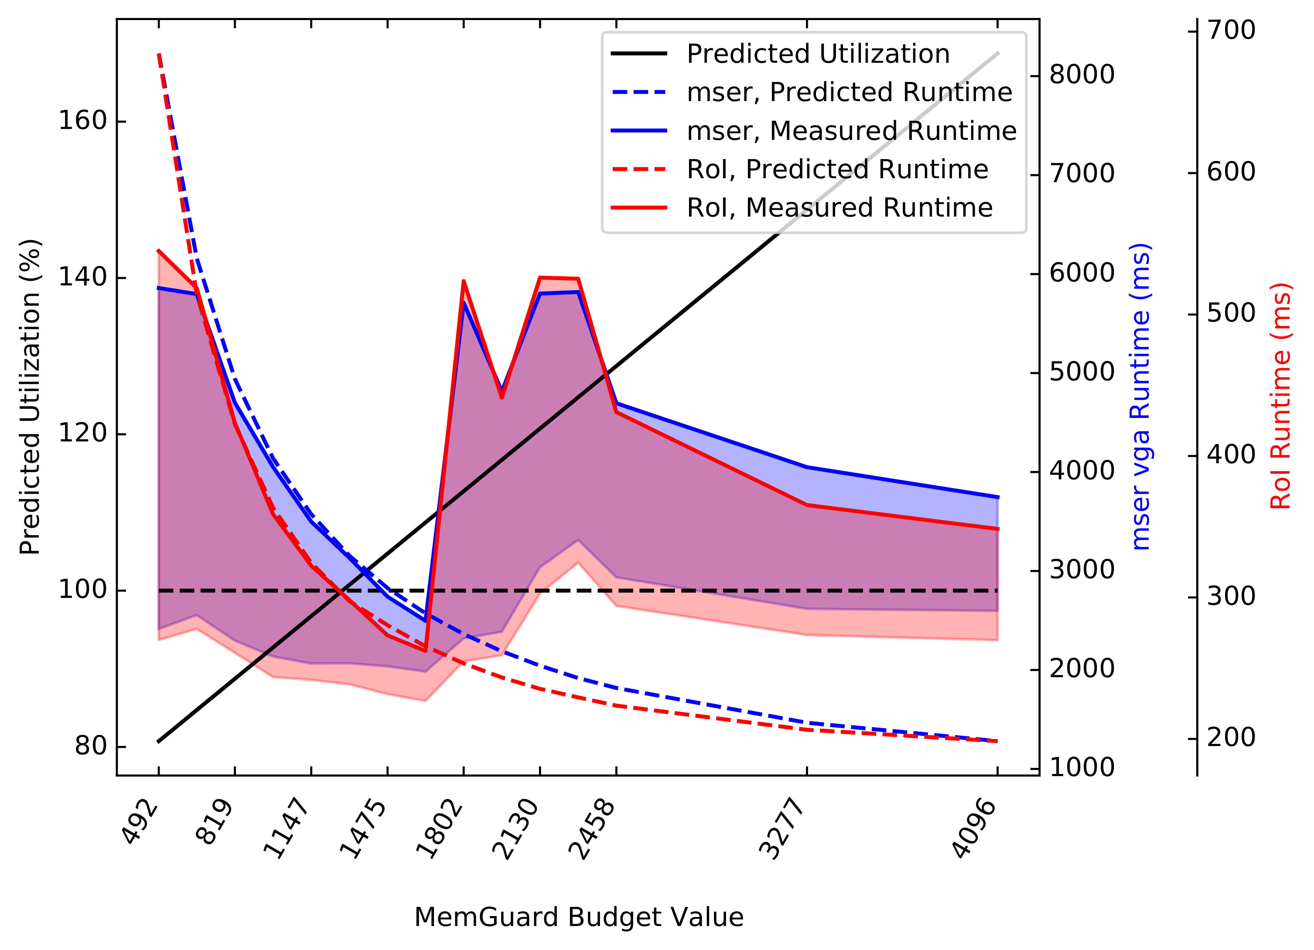
Profile-driven Workload Consolidation
ACC.1
C₂
C₁
RoI
Memory Bomb
C₃
C₄
mser
Memory Bomb

Slide 17
Concluding Remarks
Profiling
E-WarP task
Regulating PEs
Under utilization vs control knobs
Full system integration
QoS-based Regulation

Slide 18
Concluding Remarks
https://github.com/rntmancuso/jailhouse-rt
QoS-based Regulation

